Slide 1
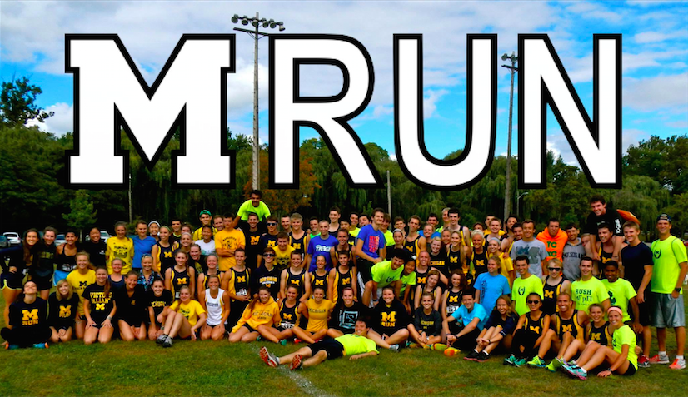
MRun Mass Meeting Fall 2014!

Slide 2

Board Introductions
Harrison Clark
President
Rob Rose
Treasurer
Caci Dishman
Vice President
John Holmes
Distance Training
Tyler Kristoff
Sprint & Field Training
Connor Murray
Travel Coordinator
Danny Sack
Social Events
Kira Burnett
Social Events
Sarah Hayes
Community Service
Eli Jenkinson
S.W.A.G.
Cassie Hoffman
Marketing & Fundraising
Emily Southern
Liaison to Club Sports
Thomas Finch
Webmaster

Slide 3
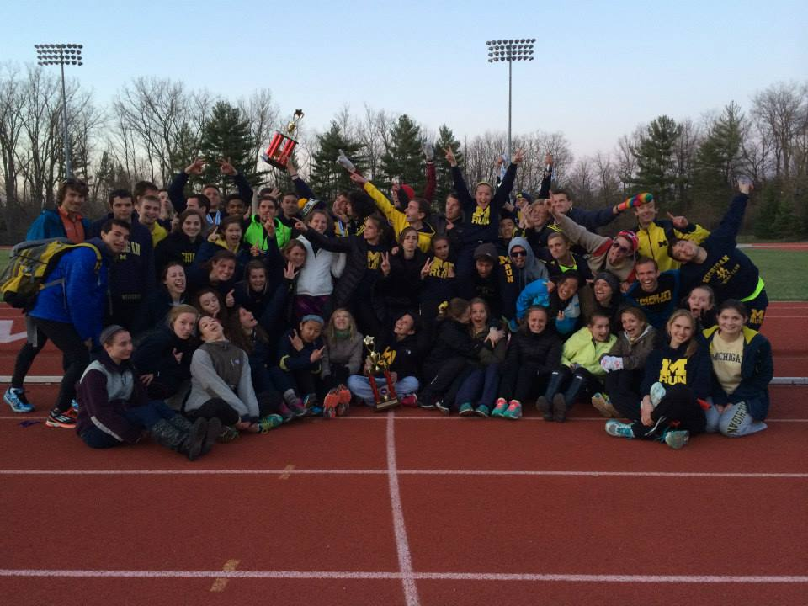
How does MRun work?
Daily Practices
Cross Country
Track & Field
Social Events
Community Service
Family
Fun!

Slide 4
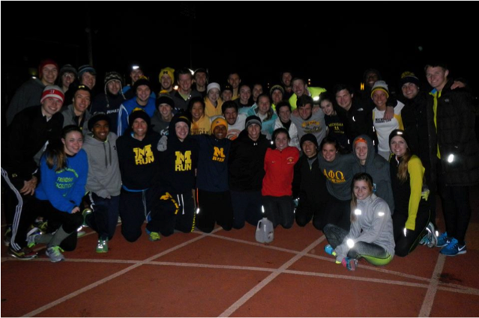
Practices & Workouts
Daily runs at 4:15pm @ CCRB Monday-Friday:
3, 5, and 7 mi routes
Sunday runs at 10:15am @ CCRB:
3, 6, 9, 12+ mi routes
Workouts:
Tuesdays at 8:30pm @ Ferry Field
Thursdays at 4:15pm @ CCRB
EVERYTHING IS OPTIONAL
We have ALL ability levels

Slide 5
Cross Country
MC5 (Anderson, IN) - $50
MSU Spartan Grand Classic (East Lansing, MI) - $20
Little Tens (New Boston, MI aka HERE) - $5
NIRCA Great Lakes Regionals (Lexington, KY) - $50
NIRCA Nationals (East Lansing, MI) - $25
(cheapest ever!!!)
MEETS ARE FUN WAYS TO GET TO KNOW PEOPLE AND COMPETE AND THEY ARE SUPER AFFORDABLE WOOOOOOOOOOOOOOOOOOO!!!!!!!!!!!!!!!!!!!!!!!!!!!!!!!!!!!

Slide 6
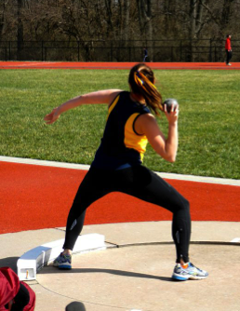
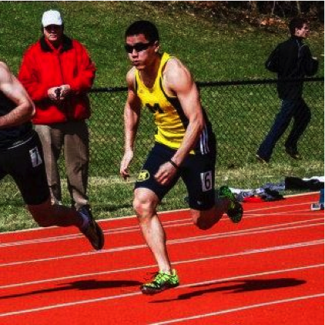
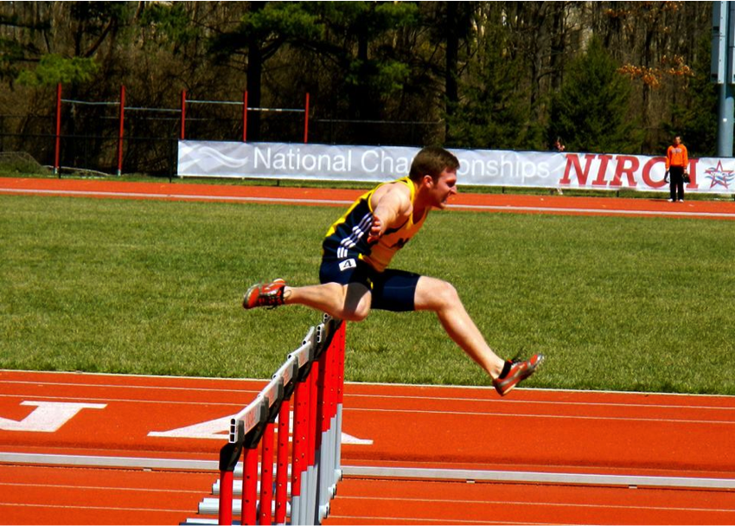
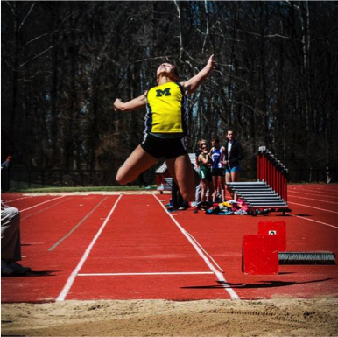
Track & Field
This Semester:
Tuesday and Thursday @ 8:30pm Ferry Field
Next Semester (Track Season):
Sprints and Hurdles
Field Events
Long Jump, High Jump, Shotput, Discus

Slide 7

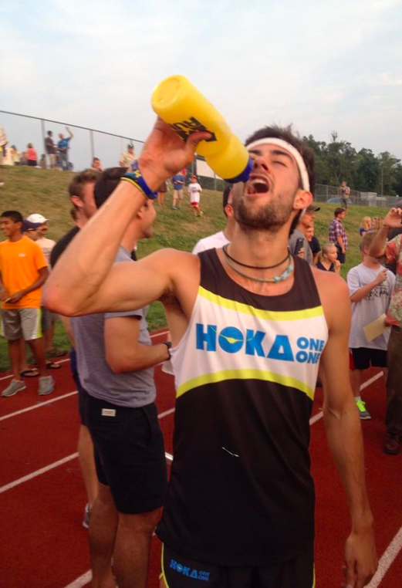
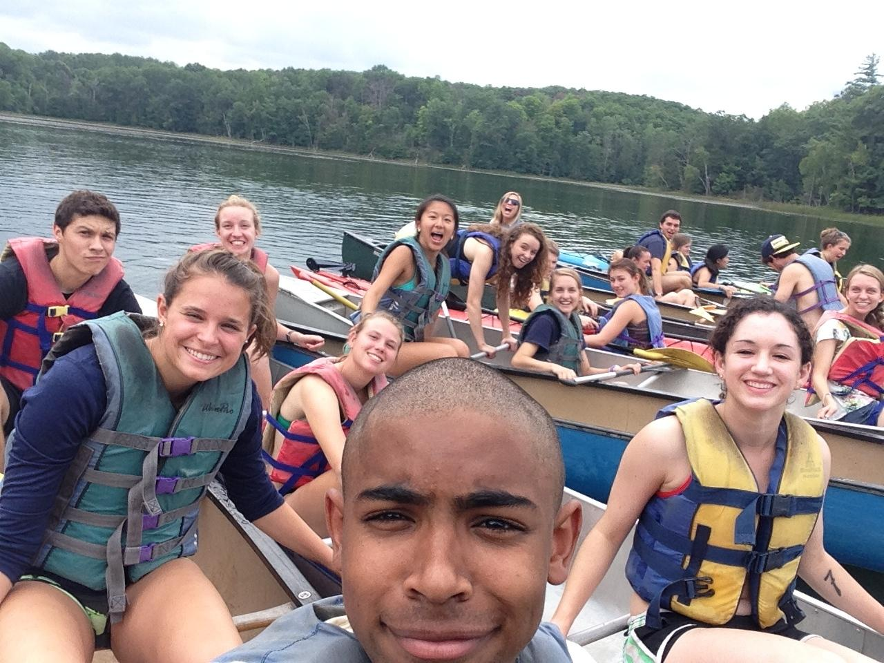
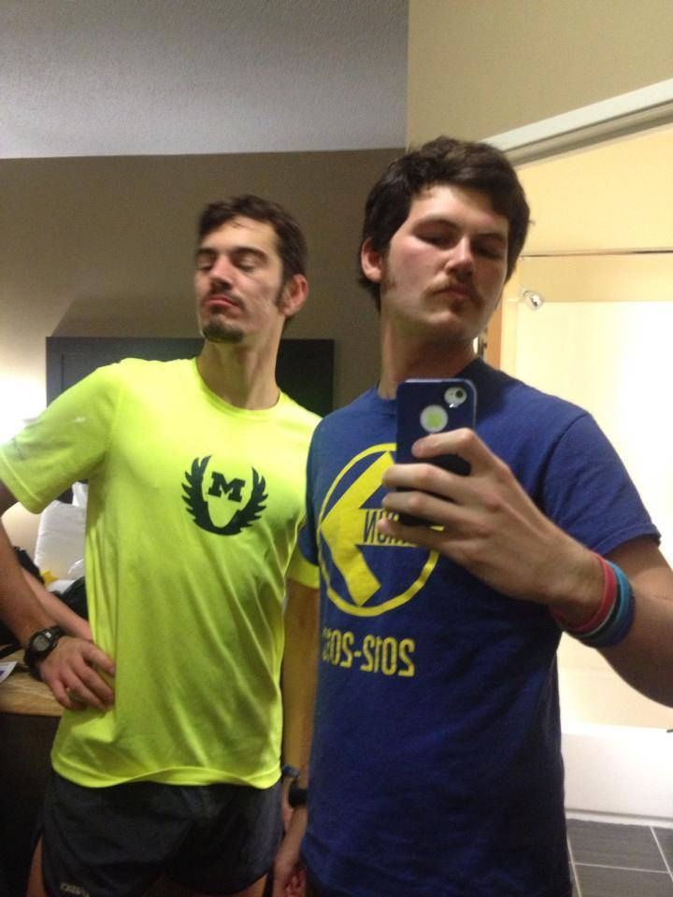
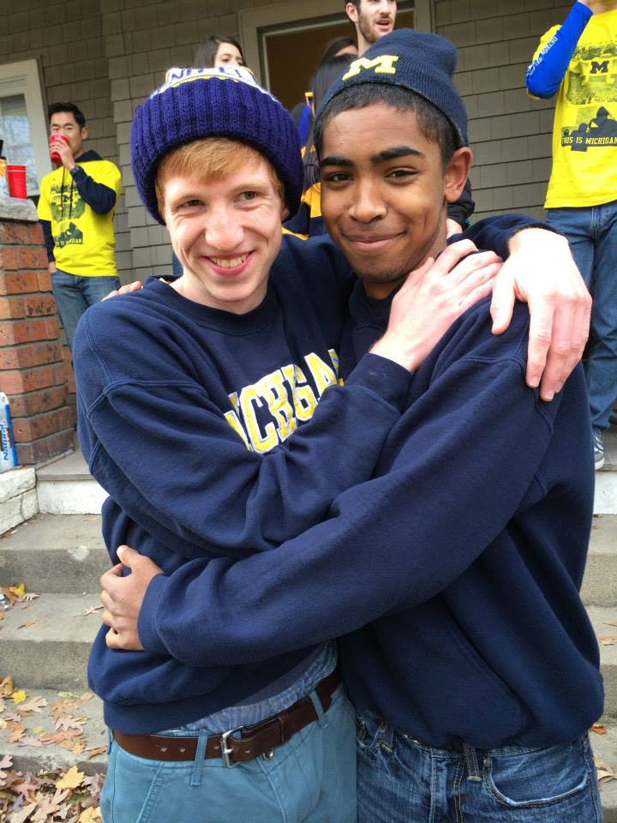
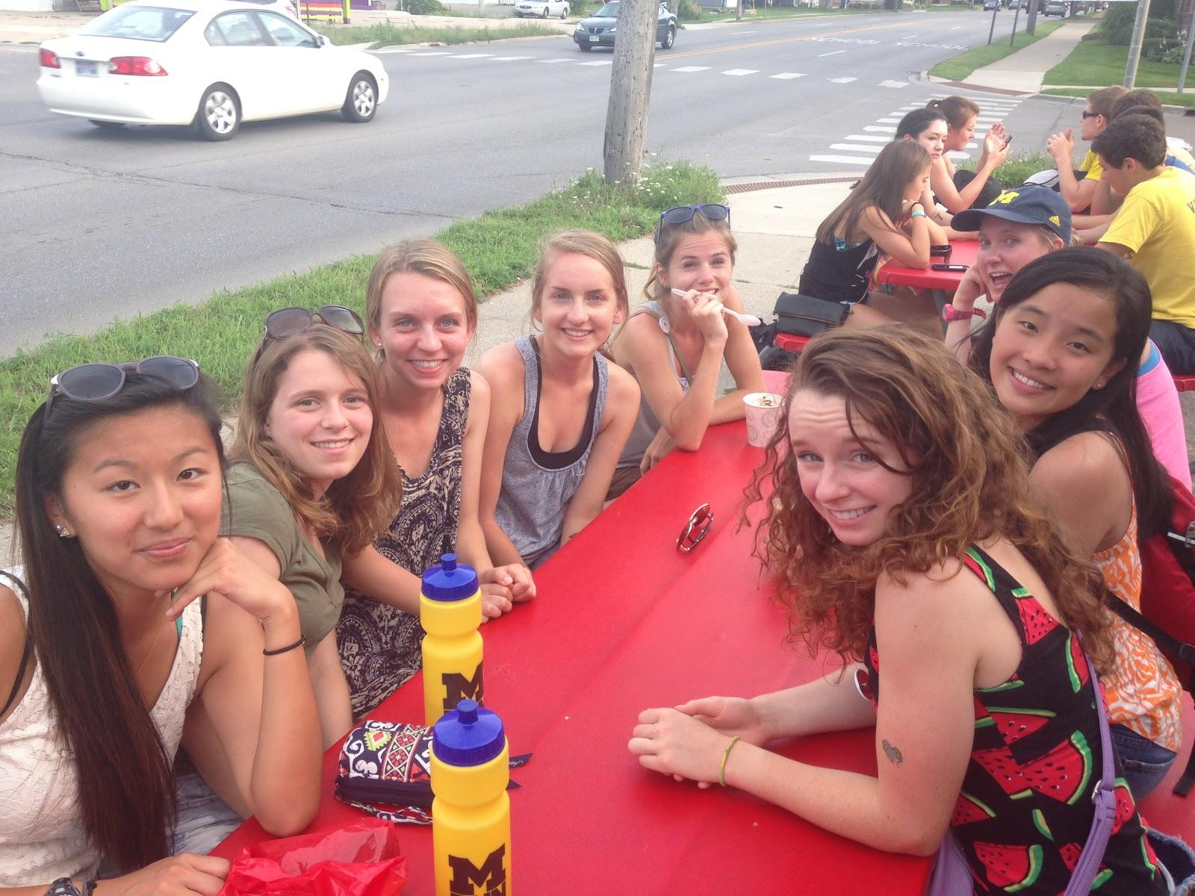
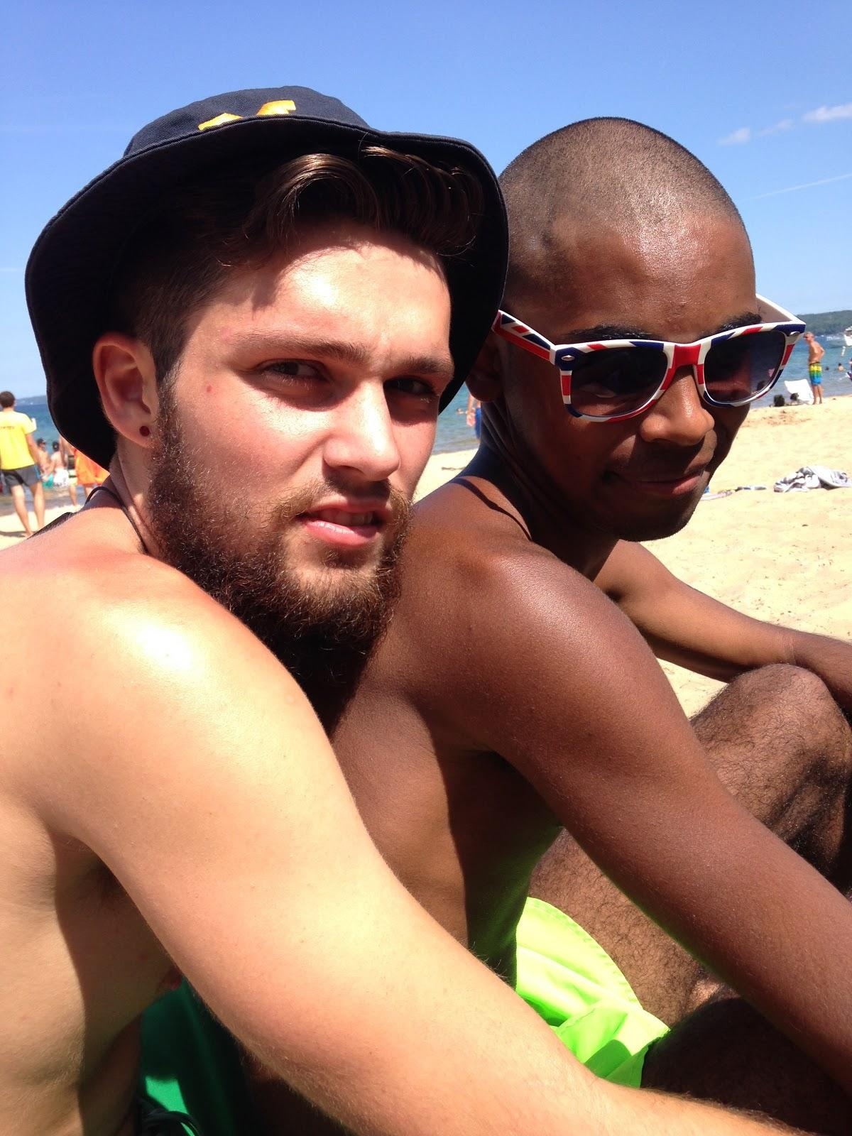
Social Events
10/5 - Cider Mill Run
10/18 - Crafts and Crafts
10/30 - Halloween Run
11/8 - Corn Maze
11/21 - Qdoba Challenge
12/12 - Festivus Party

Slide 8
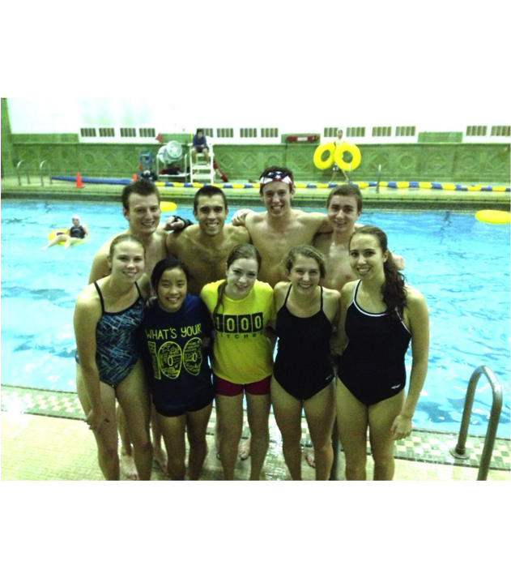
IM Sports
Fun and inviting!
Great way to hang out with MRunners outside of practice
Only ~1 hour of time commitment a week
FLAG FOOTBALL or
INNERTUBE WATER POLO
October 26th - December 9th

Slide 9
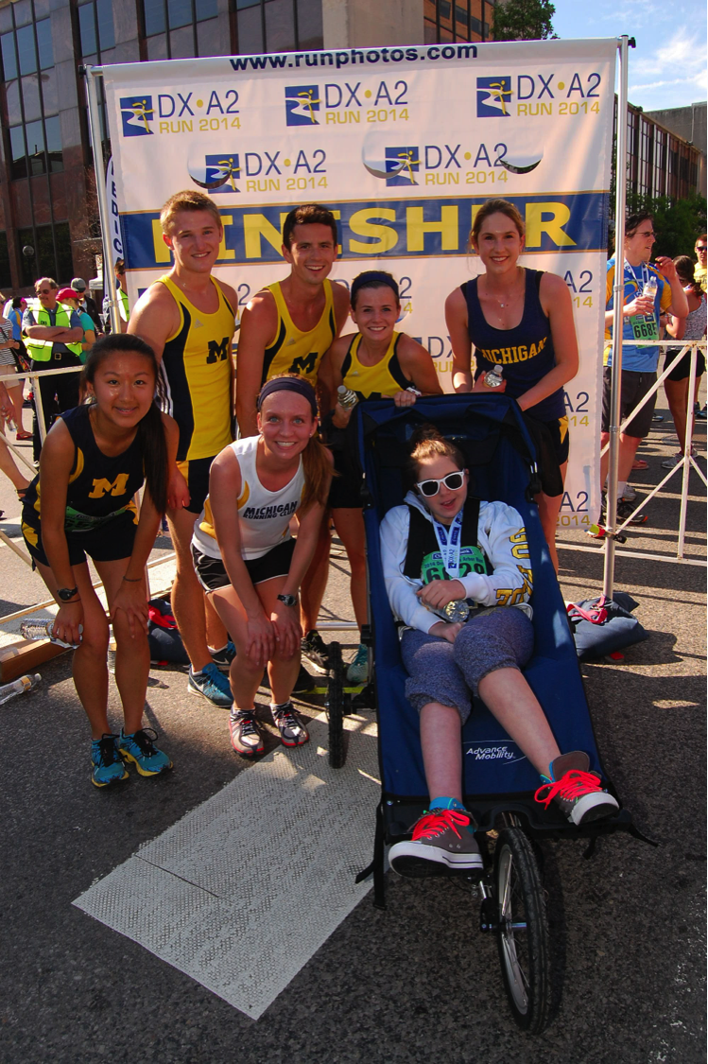
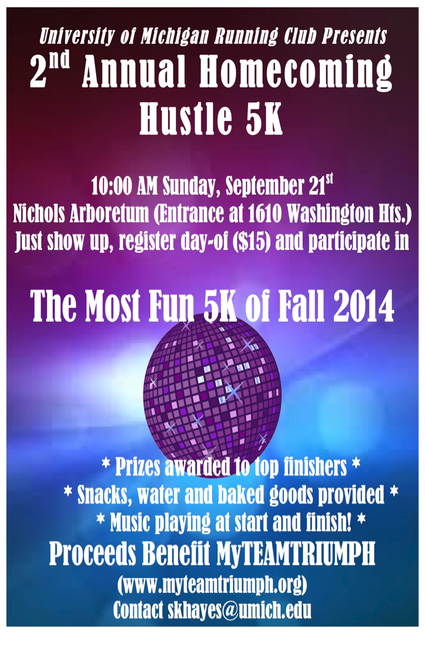
Community Service

Slide 10

Marketing / Fundraising

Slide 11
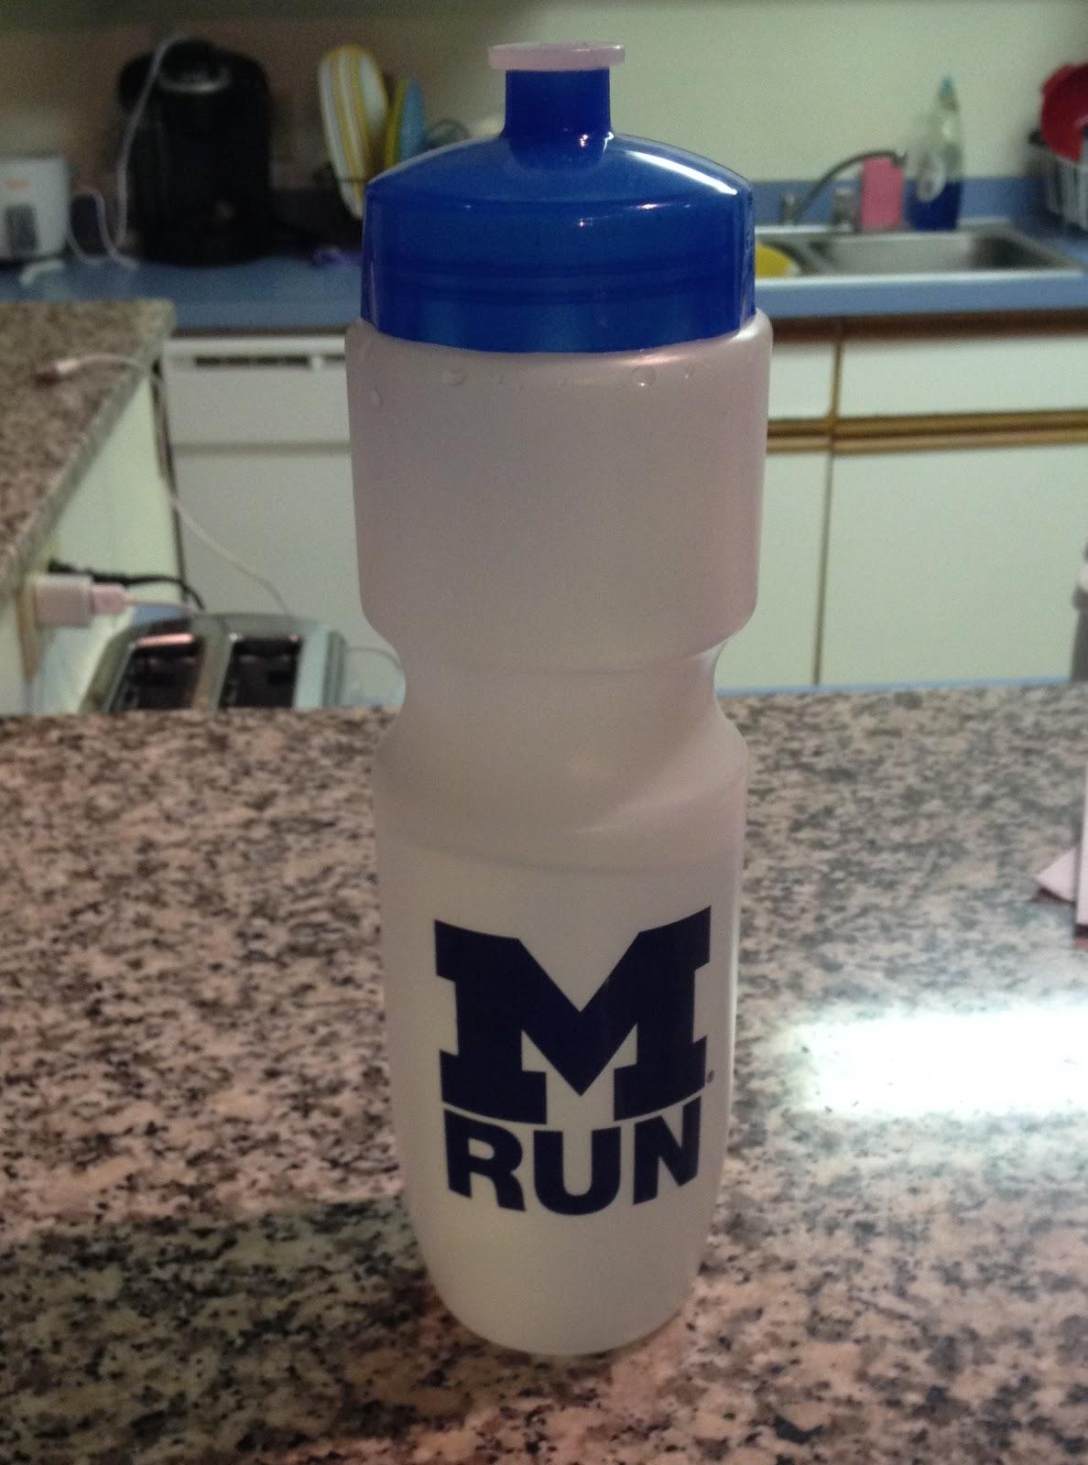
Dues
Dues are only $30!!
Cheapest Club Sport
Fall Semester
Subsidizes:
Social Events
Apparel
Traveling / Racing
Fun!
Free water bottle or wristband!

Slide 12
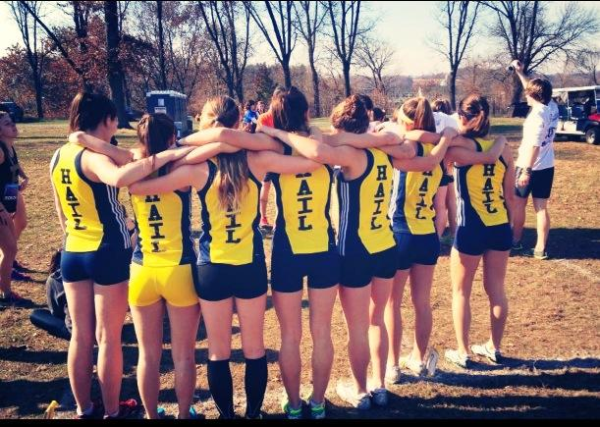
Maize Pages
Pay dues --> MRun roster on Maize Pages
Participation Agreement: must upload a photo of your health insurance card
Health insurance is required for participation in Club Sports
Must fill out Participation Agreement on Maize Pages by 9-30, or before competing!

Slide 13
Questions?
mrun.clubrunning.org
(mrun.sexy)

Slide 14
MRun Apparel and Gear!
Fall 2014

Slide 15
How It Works
Pay right now with cash or check along with your dues.
Some items are in stock; others will be ordered in the near future (new t-shirts!).
As things arrive, I will make announcements on CTools/Facebook and hold office hours, usually before/after practice.
Contact: mrun.swag@umich.edu with any questions or to buy more gear.

Slide 16
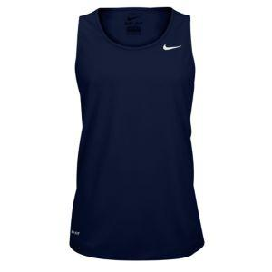

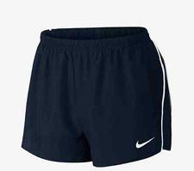
New Uniforms!
Men’s and women’s fit singlets - $20
Men’s and women’s fit shorts - $20

Slide 17
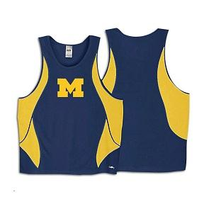
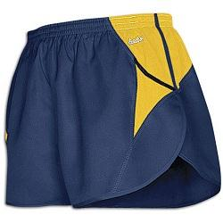
Blue Singlets and Shorts
Men's and women's fit jerseys - $15
Unisex shorts - $15

Slide 18
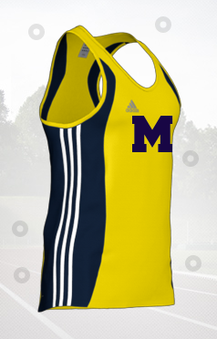
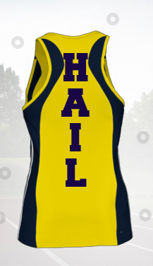
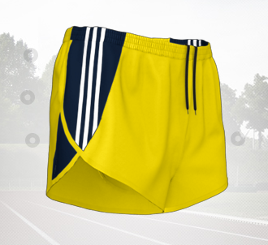
Yellow Singlets and Shorts
Men's and women's fit jerseys - $30
Men's and women's fit shorts - $30

Slide 19
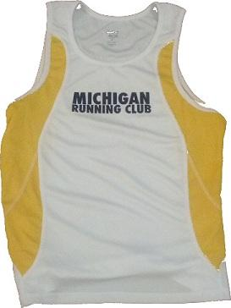
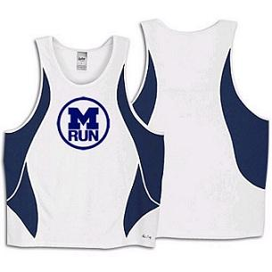
White Singlets
"Michigan Running Club" - $5
Men's and women's fit
MRun circle - $10

Slide 20
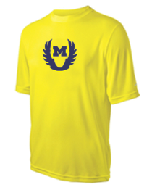
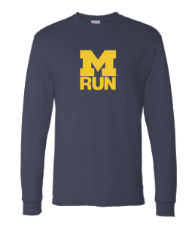
Short / Long Sleeve Tech Shirts
Men's and women's fit short sleeve - $15
Unisex long sleeve - $20

Slide 21
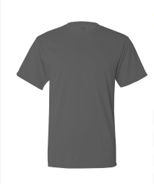
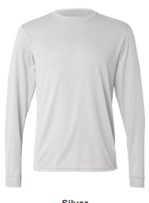
New Short / Long Sleeve Tech Shirts
Unisex short sleeve - $15
Unisex long sleeve - $20

Slide 22
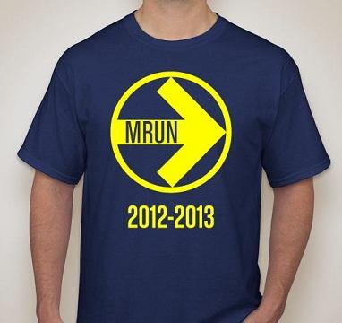
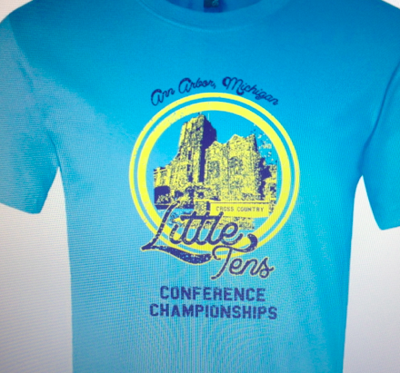
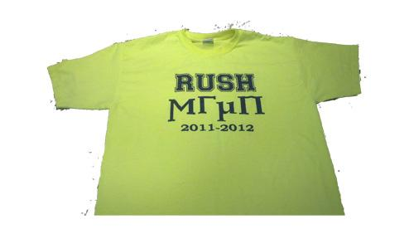
Cotton T-Shirts
2011 "Rush MRun" neon shirts - $5
2012 Arrow MRun blue shirts - $5
2013 Little Ten’s shirts - $5

Slide 23
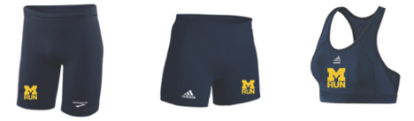
Half Tights / Spandex / Sports Bras
Men's half tights - $20
Women's half tights/spandex - $20
Sports Bras - $20

Slide 24
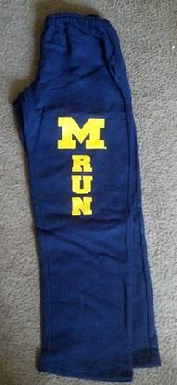
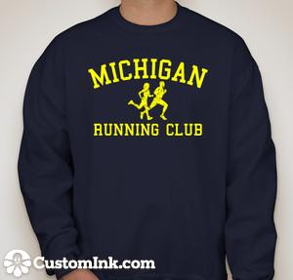
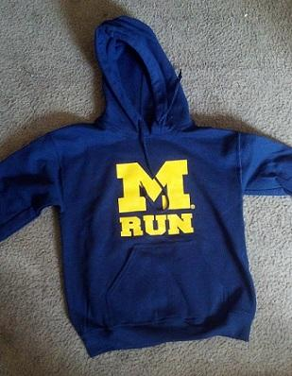
Sweatshirts / Sweatpants
Crewneck sweatshirts - $20
Hooded sweatshirts - $20
Cotton sweatpants - $20

Slide 25
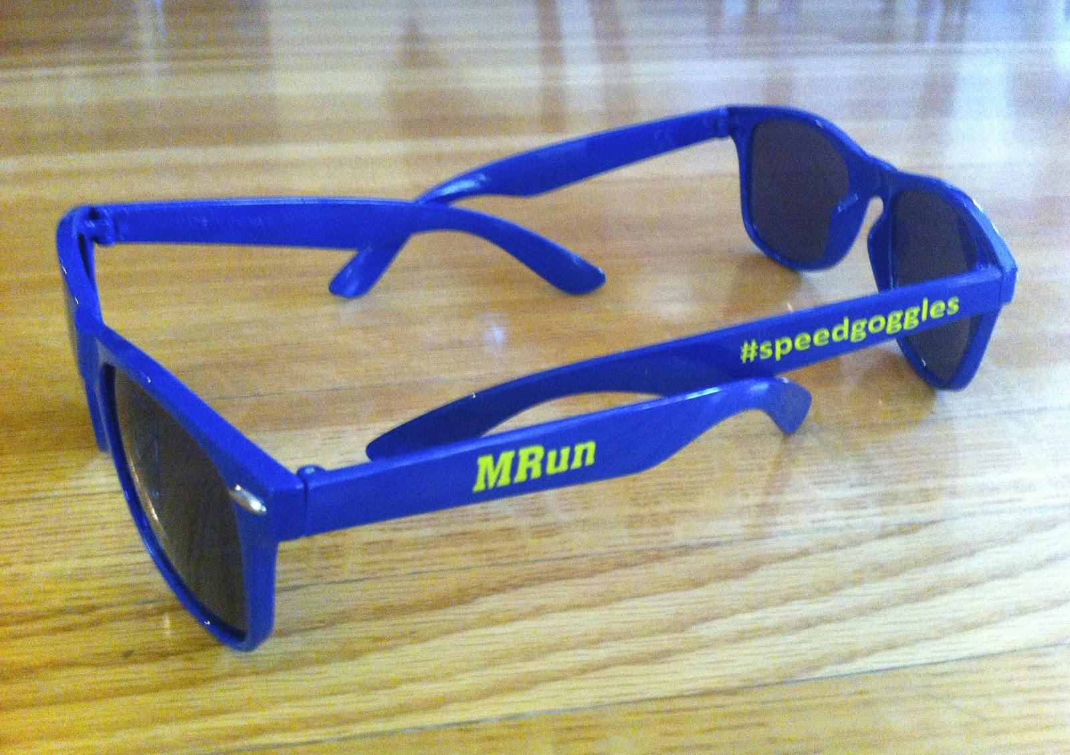

Accessories
Stickers - $1 (Coming Soon)
Sunglasses - $5

Slide 26
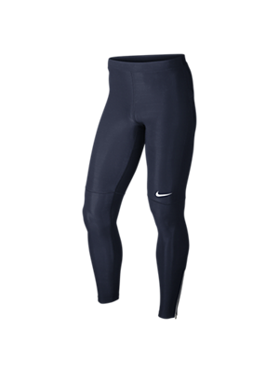
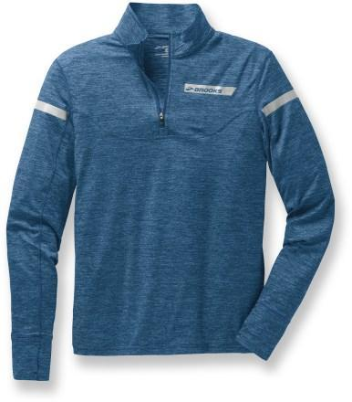
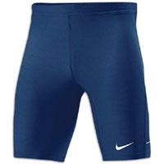

Coming Soon
Running tights - TBA (Order Soon)

Slide 27
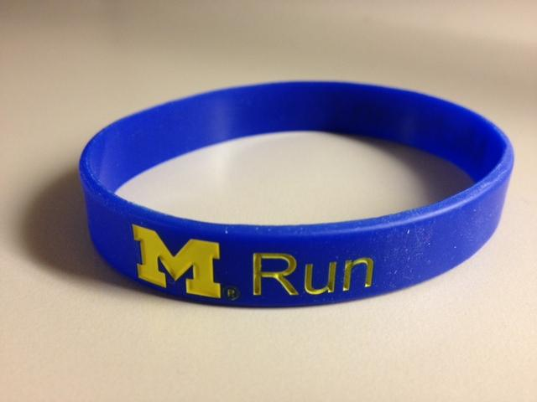
Water Bottles / Wristbands
FREE - Pick either a water bottle or wristband when you pay your dues!

Slide 28
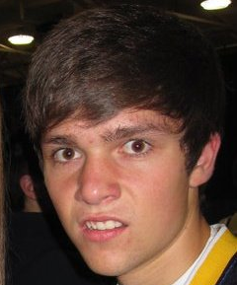
Questions?

